Slide 1
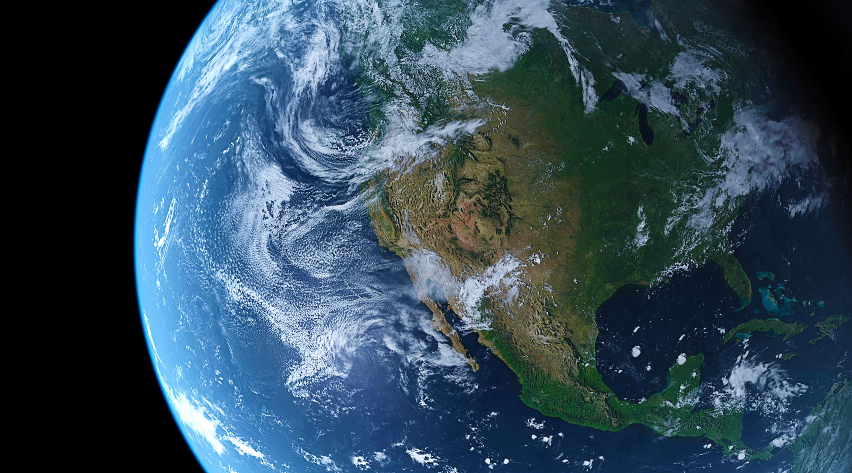
Men vs. Women
Who rules the sky (and beyond) when it comes to NASA hiring rates?
Kaity Tainer, Cynthia Cardenas, Elesha Hunter, Kendra Sawyer, Rachael Reich, Stacey Gonzalez

Slide 2







Cynthia Cardenas
BA in Elementary Education
Rachael Reich
BA Mechanical Engineering
Elesha Hunter
Stacey Gonzalez
BA Political Science
BS Sociology
MS Psychology MPH Public Health and Epidemiology Phd International Psychology
Kaity Tainer
BA Psychology
Kendra Sawyer
BS Music Education

Slide 3
Background
The 70’s: a springboard for women in astronomy
Women had worked behind the scenes since 1922
Cinema popularized women in the field
A popular one: Star Trek

Slide 4
Goals
Use Python for data analysis
Wrangle data
Data analysis
Data visualization
Gather findings

Slide 5
Assumptions/Predictions

Slide 6
Assumptions/Predictions
Methods
Next comes your methods section. This is where you talk about all of the details regarding your data. You want to give a very high level overview of what you did to:
Gather/find data
Manipulate / wrangle data
Create new variables
You also want to paint a picture of what your data is like. Include details such as:
Important variables and their summary statistics
Sample size
The methods section should only be a few slides, and should not include any code. You are presenting to a wide, non-data science audience, and thus should not go into a lot of detail.

Slide 7
Gathering Data

Slide 8
Wrangle Data
Data sets varied in information given
Needed to hone into our end goal
Data sets used:
(All will be linked and sourced here)
(Explain columns that needed to be removed or merged)

Slide 9
Variables
-

Slide 10
Exploratory Analysis

Slide 11
Correlations

Slide 12
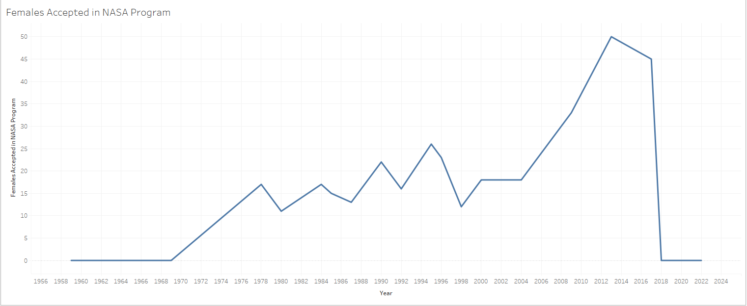
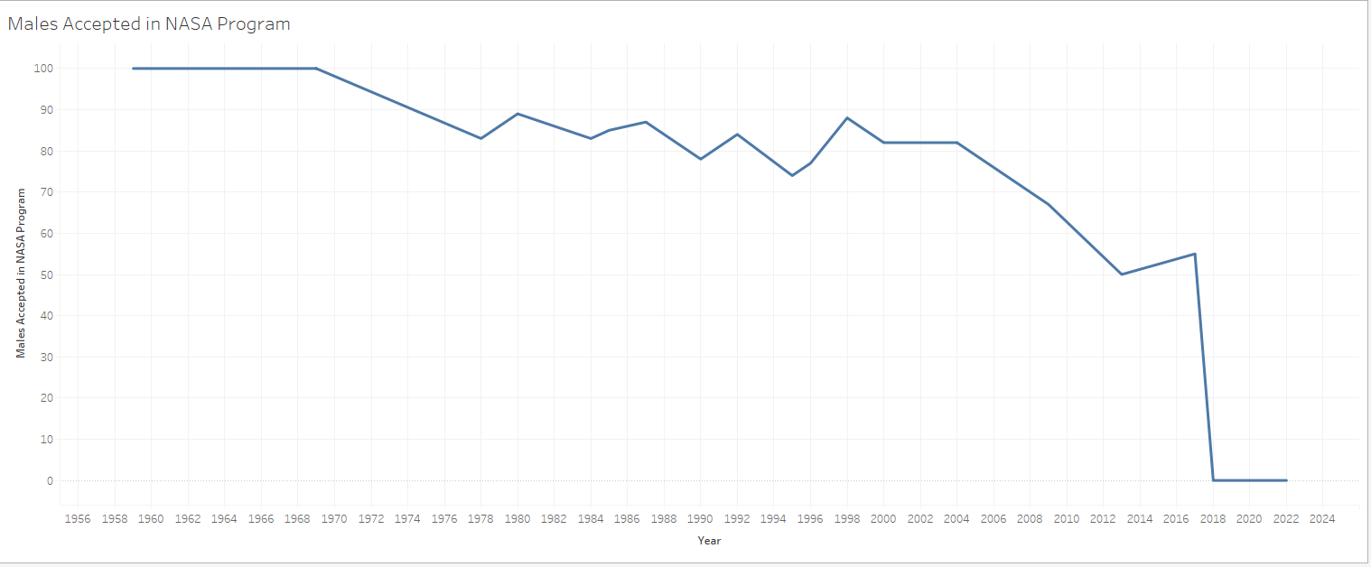

Slide 13
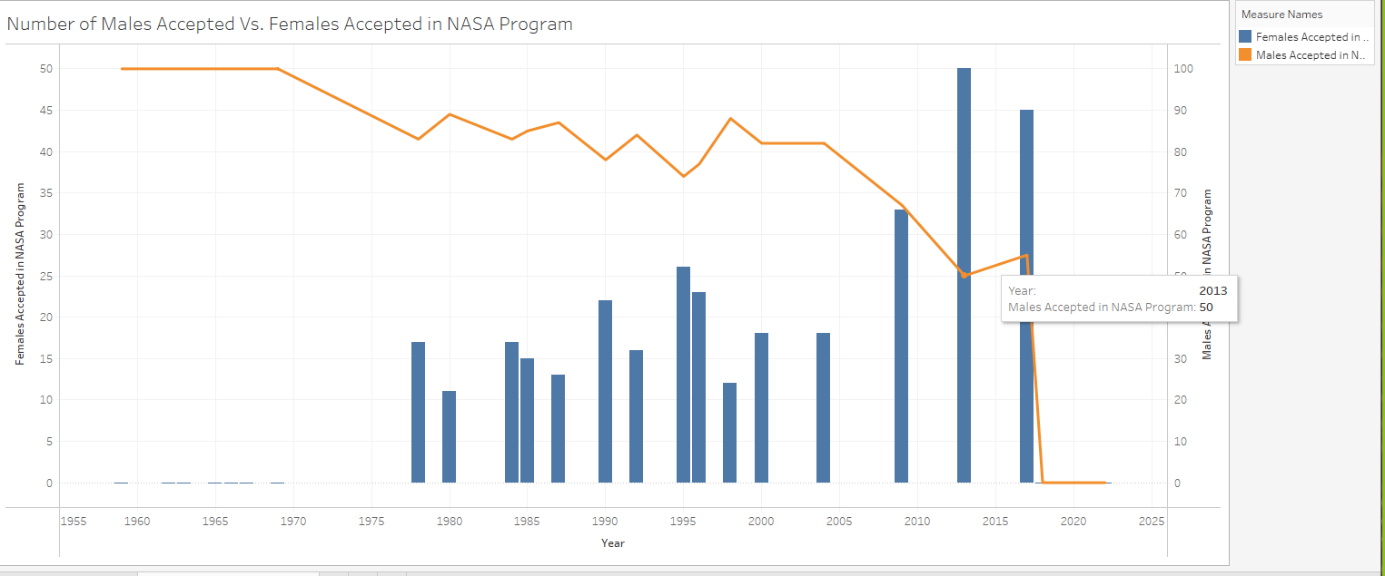

Slide 14
Data Analysis

Slide 15
Statistical Significance?

Slide 16
Summary/Regroup

Slide 17
(Next analysis questions based on what we found)

Slide 18
(Additional wrangling that was required)

Slide 19
(Visual representation for additional queries)

Slide 20
Conclusions
How do your findings impact the world at large?
Our findings impact the world at large because it paints a picture of what an astronaut looks like and makes it an achievable goal not just for men.
What's important about this work?
This work is important because it shows that this field is not just for men but anyone with in interest in space and that there is room for everyone.
Big picture information
Astronauts are becoming more and more diverse.

Slide 21
Questions?

